Slide 1

Team5: WOOWA
Notes:
매 페이지마다 브랜드 언급하기..

Slide 2
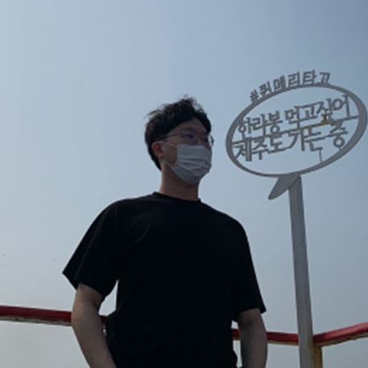
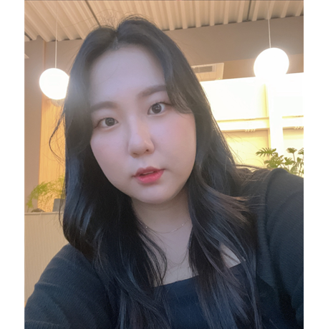



Re:Camping Team
CEO
Gyeongseo Bak
COO
Jian Ma
CTO
HakHyeon Song
CFO
Suyeon Noh
CMO
Yerin Choi

Slide 3
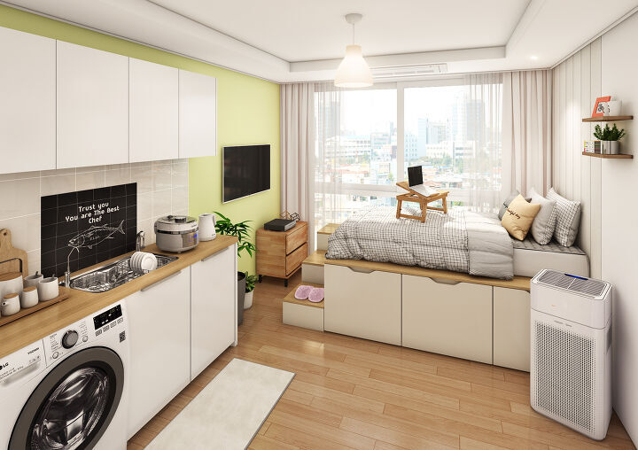
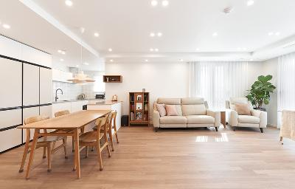
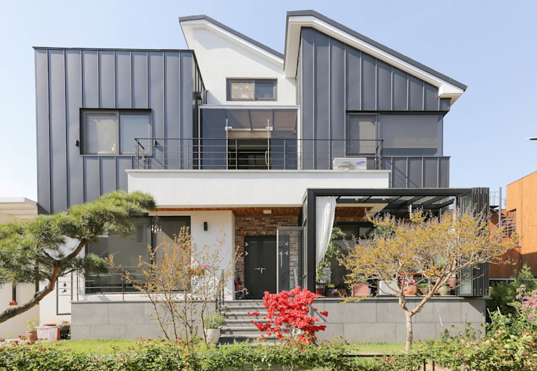
Camping market is growing
For 1person, 30m²
For 4people, 105m²
Other
For 5~8people, 230m²
Apartment
Source : Korea Tourism Organization, 2021
Source: DLAKE, 2021
Notes:
Despite the growing demand for camping equipment from young consumers, the average residential type for Koreans is an apartment or a small housing space. As a result, there is not enough space to store camping equipment that is not often used.
House -> multiflex
창고나 차고가 없다 한국에는

Slide 4

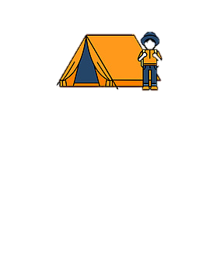





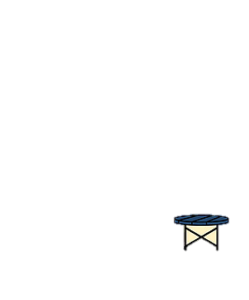
Problem
1. Spending too much money buying equipment
2. Storing camping equipment when not using is a challenge.
3. Steep investment curve for beginners
tent
mat
tarp + pack lantern
table + chair sleeping bag
⁞
No space to store
Careful management is required after use
= average spend 1138$
But used only 5 times a year
Notes:
2.(t순서변경) Storing camping equipment when not using is a challenge.
1. Spending too much money buying equipment
About -> average spend
But used only 5 times a year
3. Steep investment curve for beginners
스토리 추가 ++

Slide 5
Solution
What if I can borrow supplies when I want?
What if I could borrow the goods
and make a profit when I don’t need them?”
“Re:Camping” Service
Spending too much money
buying equipment
Storing camping equipment
when not using is a challenge.
Steep investment curve
for beginners
Low rental fee
Easy to receive and return in Local
Can save space
Community for campers
Notes:
강조하며 스피칭

Slide 6
Our Market
38.3
Source: Dlake, 2021
Male are 3.7 times more likely than Female
Notes:
//캠핑 가는 시즌(성수기)에 과연 렌트가 가능한지? 성수기 물품 공급에 대한 솔루션
//성수기엔 -> 이건 다음주꺼
제목 : Our Market 으로 변경
왼쪽 차트 숫자 입력
Purchases → purchased
캠핑 용품 마켓 시장
이 차트를 보면 20, 30대가 캠핑에 얼마나 많은 관심을 가지고 있는지 알 수 있습니다
저희는 보다 저렴한 렌탈비로 캠핑 용품을 이용할 수 있게해서 20,30대의 젊은 세대들을 공략하려고 합니다.

Slide 7



Competition
Feature | Ssangyou | Gooda | Ssocio | Re:camping
Goods Share & Rent | O | O | O | O
Goods Share & Rent request | X | O | X | O
Enterprises offer special discounts, events | X | X | O | O
Link to purchase after use | X | X | O | O
Guidelines for Beginners with challenge | X | X | X | O

Slide 8
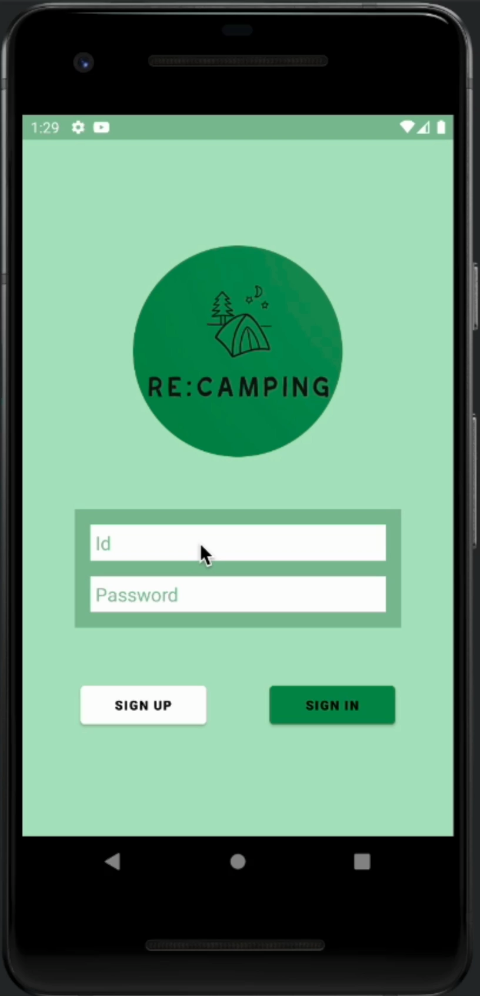
Demo
1. Borrow and Lend with your neighbors
2. Collaborate camping companies’ goods
3. Camping community
4. Category for camping beginners

Slide 9
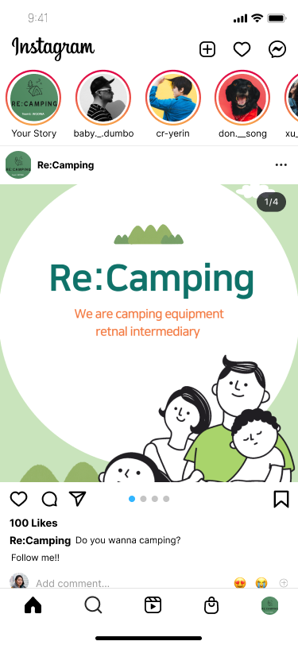
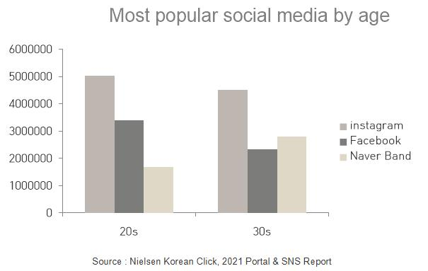
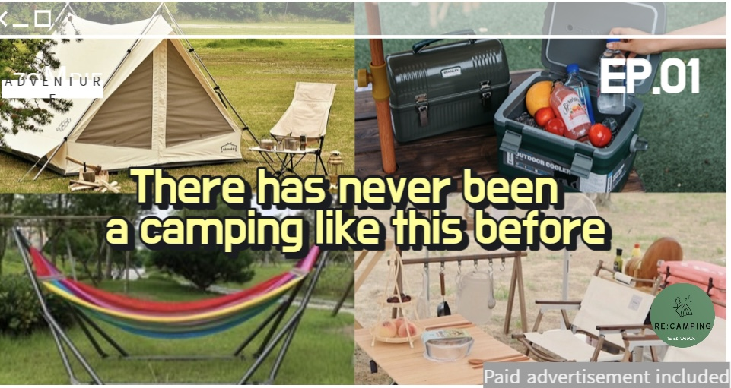
Marketing strategy
Social media utilization rate
Source : DMC Media, 2021 Social Media Market and Current Status Analysis
Notes:
국내 주요 소셜미디어별 순방문자수(UV·Unique Visitors)는 유튜브가 3천766만명으로 가장 많았다.
1인 평균 월 이용 시간은 유튜브가 1천627분으로 가장 많았다

Slide 10
Roadmap
01
02
03
04
2022.10
App release
2023.04
1. Sign partnership with camping gear companies
2. Cleaning service
2023.10
1. Challenge Feature Update, Add services for convenience
2. Delivery service
2024.04
1. Release of self-made products
2. Commencement of services for anniversaries
Focusing on sharing camping gear
Advertise and sell new camping gear, and hold events
After camping, cleaning tools
Challenges for beginners
Self-delivery service started
Making and selling good camping gears,
Anniversary Camping Supplies Delivery Service Launches
Notes:
Signed → sign
23년-클리닝 서비스, 자체배송 서비스 시작
24년- 기념일, 테마에 맞춘 캠핑 용품 세트 배송 서비스 시작
클리닝 서비스 회사와
용품 클린서비스, 기념일에 맞춘 캠핑용품 세트 배송 서비스
클리닝 서비스( 우리가 자체배송을 통해 파트너쉽을 맺어서 자체배송으로 용품을 취합한 후 클리닝서비스를 맞기고, 다시 배송해주는 서비스)

Slide 11

Pricing
Consumers
Enterprises
Transaction Fee
Individual - Individual transaction
Rental commission is 10%
Advertising Fee
Camping equipment companies advertise new products and events
5000$ per Year
Promotion or Event Goods Fee
20% of sales cost
Re:Camping
Notes:
Transaction Fee 로 변경
Rental commission 변경
Impression
$0.02 per ad impression

Slide 12
Financial Plan
Users | 40000 | 80000 | 150000 | 200000 | 400000
 | 2023 | 2024 | 2025 | 2026 | 2027
Sale | 0 | 400000 | 1125000 | 2000000 | 5000000
Promotion Fee | 270000 | 540000 | 450000 | 1350000 | 2700000
Company Ads | 10000 | 12000 | 15000 | 20000 | 25000
Commission | 120000 | 240000 | 450000 | 600000 | 1200000
Cleaning service | 260000 | 800000 | 1500000 | 2000000 | 4000000
Delivery service | 10000 | 80000 | 150000 | 200000 | 400000
Total Revenue($) | 670000 | 2072000 | 3690000 | 6170000 | 13325000
Personnel | 670000 | 1650000 | 2500000 | 3860000 | 6620000
Marketing | 70000 | 100000 | 100000 | 100000 | 80000
Produce | 50000 | 70000 | 80000 | 90000 | 10000
Server | 20000 | 40000 | 60000 | 80000 | 10000
Cleaning service | 352000 | 880000 | 1650000 | 2200000 | 4400000
Delivery service | 7500 | 60000 | 112500 | 150000 | 300000
Total Expense($) | 1169500 | 2800000 | 4502500 | 6480000 | 11420000
Investment Needed per Year | -499500 | -728000 | -812500 | -310000 | 1905000

Slide 13
Financial Plan
Investment ask 3$M
Notes:
콤마
2.5m$
Investment ask 2.5$M

Slide 14
Thank You

